Slide 1
CSE1201: Object Oriented Programming-I (C++)
Lecture 12

Slide 2
Outline
Type conversion and type cast
The This pointer
Pointers to derived types
Pointers to class members
Dynamic memory allocation in C++

Slide 3
Type Conversion in Assignment
In an assignment statement, in which the type of the right side differs from the left, the type of the right side is converted into that of the left
When the left side is larger than the type of the right side, this process causes no problem
However, when the type of the left side is smaller than the type of the right, data loss may occur

Slide 4
Type Conversion in Assignment
When the type of the right side is larger than the type of the left side, the basic rule is that the appropriate number of high order bits will be removed
However, when converting from a floating point value to an integer value, the fractional part is lost, and if the number is too large to fit in the integer type, a garbage value will result
What will happen when a character variable holds a value greater than 127 is implementation dependent

Slide 5
Type Conversion
C++ allows us to convert data of one type to that of another. This is known as type conversion.
There are two types of type conversion in C++.
Implicit Conversion
Explicit Conversion (also known as Type Casting)

Slide 6
Implicit Conversion
The type conversion that is done automatically done by the compiler is known as implicit type conversion.
This type of conversion is also known as automatic conversion.
// Working of implicit type-conversion
#include <iostream>
using namespace std;
int main() {
// assigning an int value to num_int
int num_int = 9;
// declaring a double type variable
double num_double;
// implicit conversion
// assigning int value to a double variable
num_double = num_int;
cout << "num_int = " << num_int << endl;
cout << "num_double = " << num_double << endl;
return 0;
}
Output
num_int = 9
num_double = 9

Slide 7
Implicit Conversion
//Working of Implicit type-conversion
#include <iostream>
using namespace std;
int main() {
int num_int;
double num_double = 9.99;
// implicit conversion
// assigning a double value to an int variable
num_int = num_double;
cout << "num_int = " << num_int << endl;
cout << "num_double = " << num_double << endl;
return 0;
}
Output
num_int = 9
num_double = 9.99

Slide 8
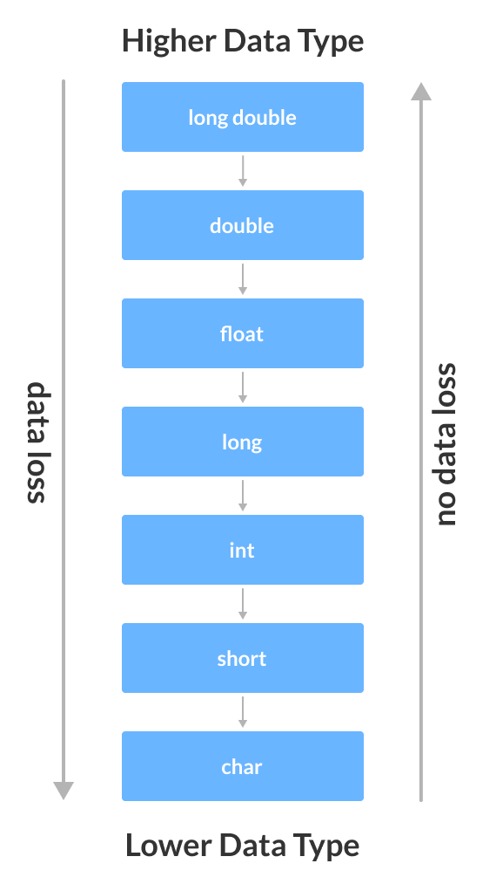
Implicit Conversion

Slide 9
Explicit Conversion
When the user manually changes data from one type to another, this is known as explicit conversion.
This type of conversion is also known as type casting.
Type casting is used to transform the type of a variable temporarily
General form: (data type) expression
where data type is the name of a valid c/c++ data type
Example:
int a = 5, b =6;
double c = (double)a/b;

Slide 10
Explicit Conversion
There are three major ways of explicit conversion in C++.
C-style type casting (also known as cast notation)
Function notation (also known as old C++ style type casting)
Type conversion operators (out of scope)

Slide 11
Explicit Conversion
Cast Notation
The syntax for this style is:
(data_type)expression;
#include <iostream>
using namespace std;
int main()
{
double dbl1 = 8.9;
// Explicit conversion from double to int
int res = (int)dbl1 + 1;
cout << "Result = " << res;
return 0;
}
Output
Result = 9

Slide 12
Explicit Conversion
Function-style Casting
The syntax for this style is:
data_type(expression);
#include <iostream>
using namespace std;
int main() {
// initializing a double variable
double num_double = 3.56;
cout << "num_double = " << num_double << endl;
// C-style conversion from double to int
int num_int1 = (int)num_double;
cout << "num_int1 = " << num_int1 << endl;
// function-style conversion from double to int
int num_int2 = int(num_double);
cout << "num_int2 = " << num_int2 << endl;
cout << "num_double = " << num_double << endl;
return 0;
}
Output
num_double = 3.56
num_int1 = 3
num_int2 = 3
num_double = 3.56

Slide 13
The this pointer
When a member function is called, it is automatically passed an implicit argument that is a pointer to the invoking object (that is, the object on which the function is called).
This pointer is called this.
friend functions are not members of a class therefore, are not passed a this pointer.
static member functions do not have a this pointer.

Slide 14
The this pointer
this pointer is generally used to access member variables that have been hidden by local variables having the same name inside a member function
class A{
int x;
public:
A(int x) {
x = x; // only copies local ‘x’ to itself; the member ‘x’ remains uninitialized
this->x = x; // now its ok
}
void f1() {
int x = 0;
cout << x; // prints value of local ‘x’
cout << this->x; // prints value of member ‘x’
}
};

Slide 15
Pointer to derived types
In general, a pointer of one type cannot point to an object of a different type.
there is an important exception to this rule that relates only to derived classes
A base class pointer can also be used as a pointer to an object of any class derived from that base.
But the opposite is not true.

Slide 16
Pointer to derived types
#include <iostream>
using namespace std;
class base {
int i;
public:
void set_i(int num) { i=num; }
int get_i() { return i; }
};
class derived: public base {
int j;
public:
void set_j(int num) { j=num; }
int get_j() { return j; }
};
int main()
{
base *bp;
derived d;
bp = &d; // base pointer points to derived object
// access derived object using base pointer
bp->set_i(10);
cout << bp->get_i() << " ";
/* The following won't work.
bp->set_j(88); // error
cout << bp->get_j(); // error
*/
return 0;
}

Slide 17
Pointer to derived types
When using a base pointer to point to a derived object, you can access only the members of the derived type that were inherited from the base.
you won't be able to access any members added by the derived class.
It is possible to cast a base pointer into a pointer of the derived type to access a member of the derived class through the base pointer.
For example, this is valid C++ code:
// access now allowed because of cast
((derived *)bp)->set_j(88);
cout << ((derived *)bp)->get_j();

Slide 18
Dynamic memory allocation in C++
C++ introduces two operators to dynamically allocate and free memory :
p_var = new type
new returns a pointer to dynamically allocated memory that is sufficient to hold a data object of type type
delete p_var
releases the memory previously allocated by new
Memory allocated by new must be released using delete

Slide 19
Using new and delete
Example:
int *p = new int;
delete p;
In case of insufficient memory, new can report failure in two ways
By returning a null pointer
By generating an exception
The reaction of new in this case varies from compiler to compiler

Slide 20
Using new and delete
Advantages
No need to use sizeof operator while using new.
New automatically returns a pointer of the specified type.
In case of objects, new calls dynamically allocates the object and call its constructor
In case of objects, delete calls the destructor of the object being released

Slide 21
Using new and delete
Dynamically allocated objects can be given initial values.
int *p = new int;
Dynamically allocates memory to store an integer value which contains garbage value.
int *p = new int(10);
Dynamically allocates memory to store an integer value and initializes that memory to 10.
Note the use of parenthesis ( ) while supplying initial values.

Slide 22
Allocation of objects
class A{
int x;
public:
A(int n) { x = n; }
};
A *p = new A(10);
Dynamically allocates memory to store a A object and calls the constructor A(int n) for this object which initializes x to 10.
A *p = new A;
It will produce compiler error because in this example class A does not have a default constructor.

Slide 23
Allocation of Arrays
We can create dynamically allocated arrays using new.
But deleting a dynamically allocated array needs a slight change in the use of delete.
It is not possible to initialize an array that is dynamically allocated.
int *a= new int[10];
Creates an array of 10 integers
All integers contain garbage values
Note the use of square brackets [ ]
delete [ ] a;
Delete the entire array pointed by a
Note the use of square brackets [ ]

Slide 24
Allocation of Arrays of Objects
It is not possible to initialize an array that is dynamically allocated. In order to create an array of objects of a class, the class must have a default constructor.
class A {
int x;
public:
A(int n) { x = n; } };
A *array = new A[10];
// compiler error
class A {
int x;
public:
A() { x = 0; }
A(int n) { x = n; } };
A *array = new A[10]; // no error
// use array
delete [ ] array;

Slide 25
Allocation of Arrays of Objects
A *array = new A[10];
The default constructor is called for all the objects.
delete [ ] array;
Destructor is called for all the objects present in the array.

Slide 26
Dynamic memory allocation
Memory in your C++ program is divided into two parts −
The stack − All variables declared inside the function will take up memory from the stack.
The heap − This is unused memory of the program and can be used to allocate the memory dynamically when program runs.
Dynamic memory is allocated at run time within the heap for the variable of a given type using new operator

Slide 27
Dynamic memory allocation
There may be cases where the memory needs of a program can only be determined during runtime
For example, when the memory needed depends on user input
Dynamic memory is allocated at run time within the heap for the variable of a given type using new operator

Slide 28
Reference
Chapter 13
[ C++ : The complete reference ]

Slide 29
Thank you

